Slide 1

IMMERSE PRESENTATION Aeronautical Mobile Telemetry
Benjamin Havens
25 May 2022

Slide 2
Outline
Background—what is AMT?
The problem we’re addressing—what is multipath transmission?
Solutions—what are combining and equalizing?
Past work
Current work
Future work
Ethics
Conclusion

Slide 3
Background—What is AMT?
Telemetry is on-site measurement and data collection, relayed, analyzed, and stored remotely
For aeronautical telemetry, the remote or inconvenient place data is collected is an aircraft or other airborne test article.
Difficulties in AMT:
Mobile
High bitrate
Polarization
Unfamiliar environment
Notes:
First bullet: when measuring someplace remote or inconvenient Second bullet: all military, commercial, civilian aircraft (passenger-carrying) must be thoroughly

Slide 4
Problem: Multi-path transmission
Three paths of transmission: LOS, specular, diffuse
LOS: Line of sight from transmitter to receiver
Specular: “Like a mirror.” Dried lakebeds, etc.
Diffuse: Reflection off rough surfaces, like a mountain

Slide 5
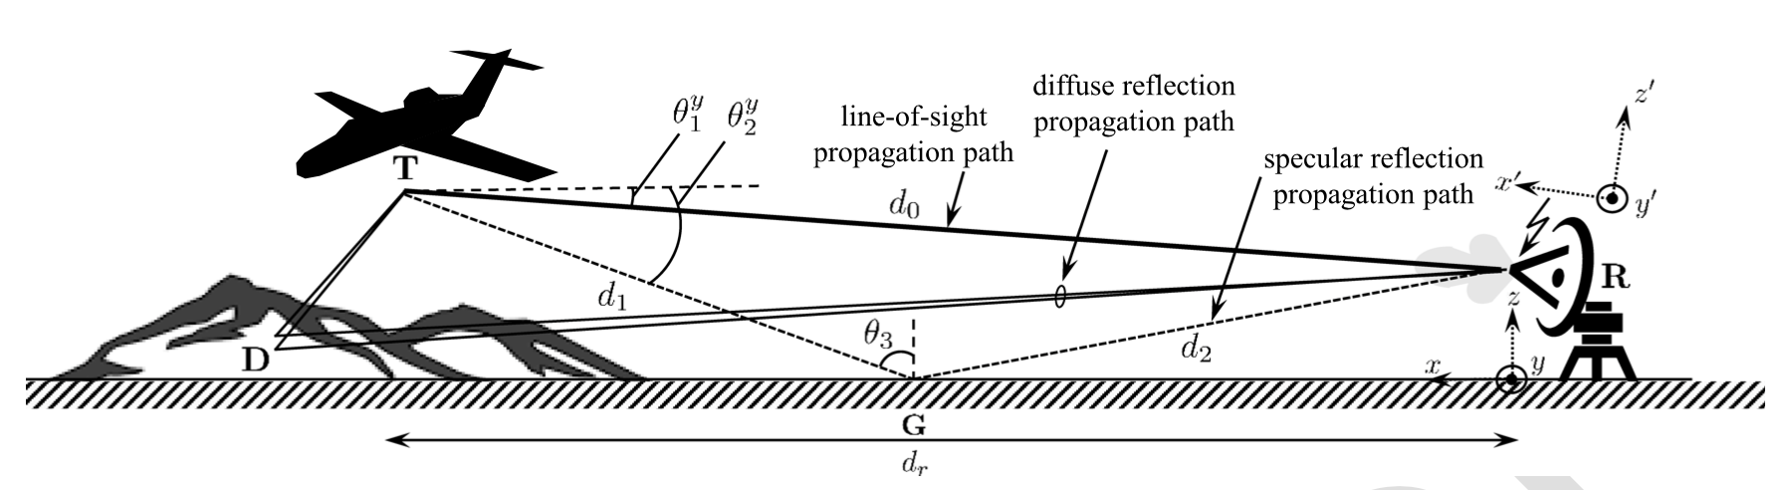
From Arabian and Rice (Figure 2)

Slide 6
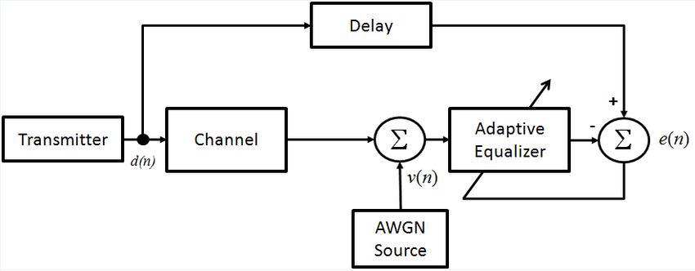
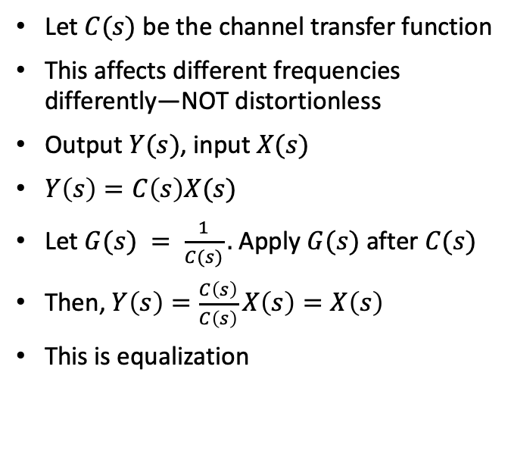
Signals and systems perspective on multi-path transmission
Let $C(s)$ be the channel transfer function
This affects different frequencies differently—NOT distortionless
Output $Y(s)$, input $X(s)$
$Y\left(s\right)=C\left(s\right)X(s)$
Let $G(s) = \frac{1}{C(s)}.$Apply $G(s)$ after $C(s)$
Then, $Y\left(s\right)=\frac{C\left(s\right)}{C\left(s\right)}X\left(s\right)=X\left(s\right)$
This is equalization

Slide 7
Solution: combining and equalization
Undistort the signal, so less bits are dropped (i.e., bit error rate is our performance metric).
Because of polarization, we have 2 antennas anyway. “Combining” refers specifically to how we combine those signals
Send a pilot → determine the frequency domain impact of transmission on your signal → use this information to construct an equalizer on the fly

Slide 8
Past work: A new combining strategy
There have been several approaches to combining and equalization
Farah Arabian and Dr. Rice explored a maximum-likelihood method
Simulink/MATLAB code that does this in discrete time
Tested using past data from a test flight at Edwards Air Force Base, CA
This performed comparably to SOTA techniques

Slide 9
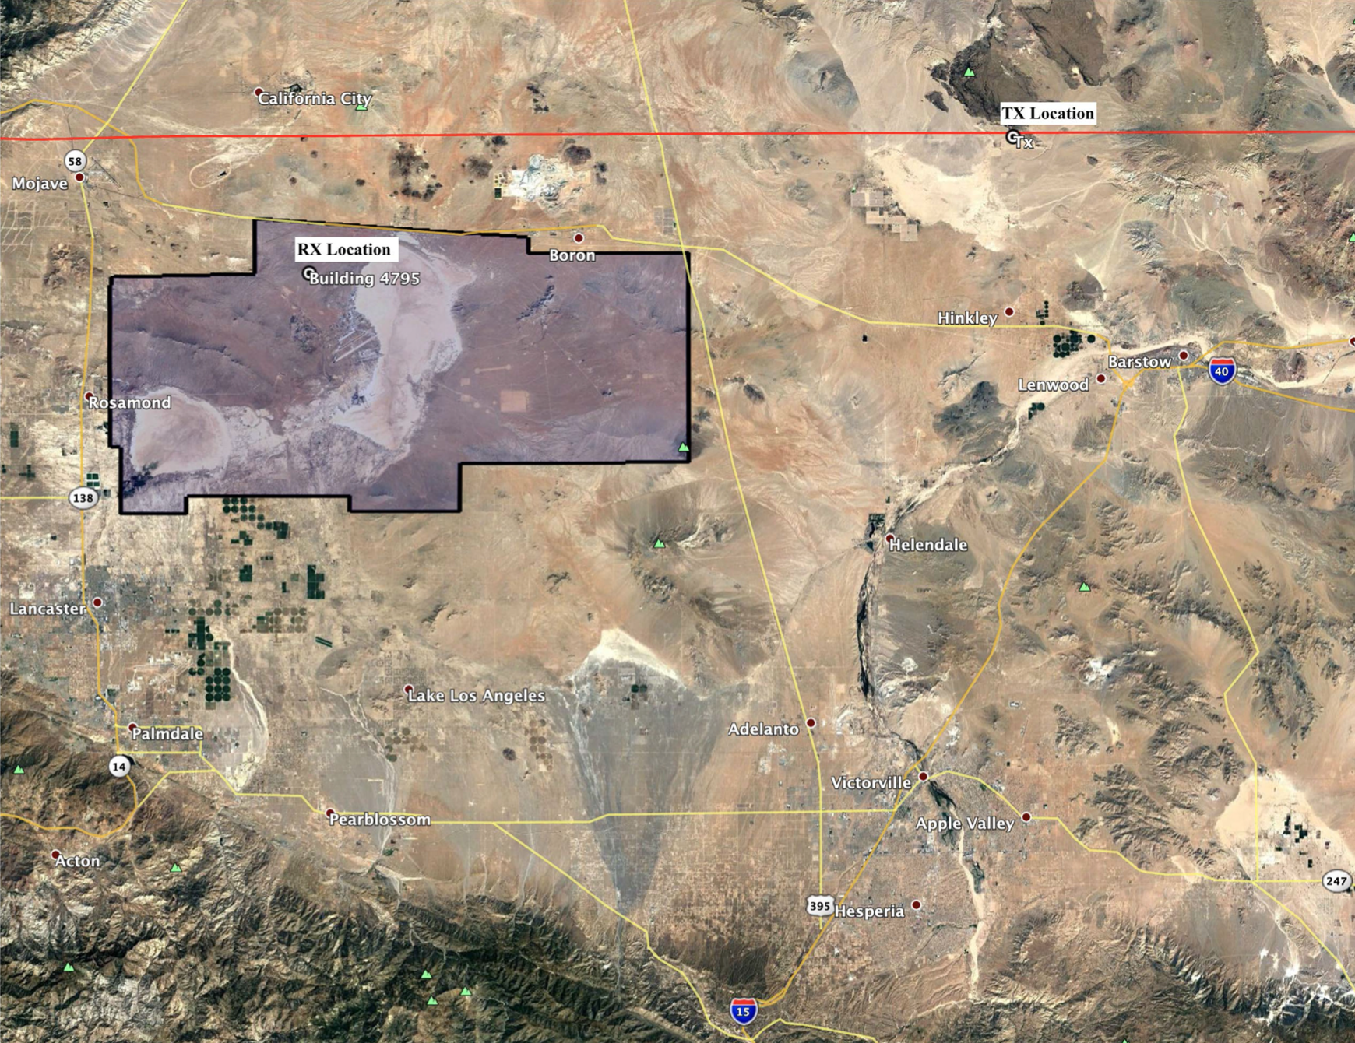
From Arabian and Rice (Figure 3)

Slide 10
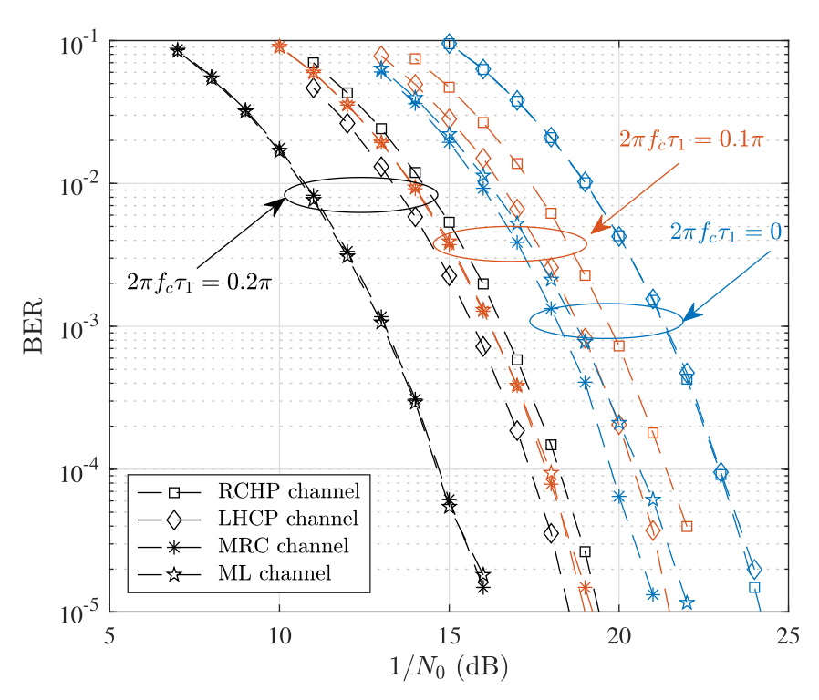
From Arabian and Rice (Figure 5)

Slide 11
Current Work: Test cases for further comparison
On some preliminary cases, the method from Arabian and Rice outperformed MRC, a very widespread technique
We want to further validate this technique
Measuring the channel impulse responses for the vertical and horizontal antenna
Submitting to the International Telemetering Conference
Notes:
In exotic Glendale, AZ

Slide 12
Future work
Further equalization techniques
Security in transmission
Want to learn more? Take ECEN 485 and 487

Slide 13
Ethics
Don’t promote a new method until it’s better than the old one
How do flight tests impact the environment?
What level of bit error rate is acceptable, considering this is used to test passenger-carrying flights?

Slide 14
Conclusion
AMT is the set of techniques used to monitor airborne vehicles during testing
Multi-path transmission, among other complications, make this more difficult
Combining and equalization offer a solution that reduces the bit error rate by as much as a factor of 1000, depending on noise level
ML-inspired combining is promising; we are providing further validation for it
Reliable telemetry is critical for safe flights
Notes:
I love the little pictures Powerpoint came up with for these bullets

Slide 15
References
Arabian, F., & Rice, M. (2022). On Polarization, Combining, and Equalization in Aeronautical Mobile Telemetry (dissertation). IEEE Transactions on Aerospace and Electronic Systems, March 2022.

